Slide 1
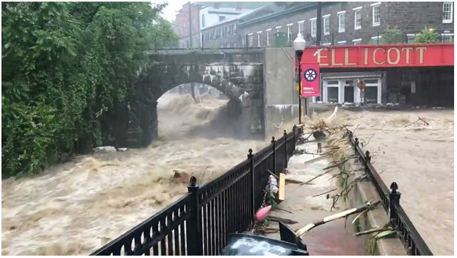
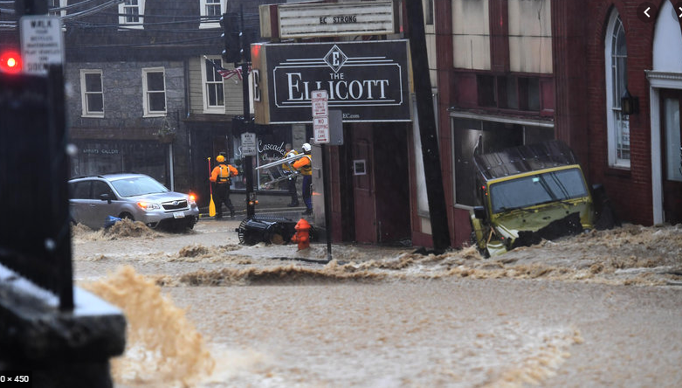
Flooding In Ellicott city
-Emmanuel Vas

Slide 2
PROBLEM STATEMENT
Low elevation
Historically prone to flooding
Constructed to withstand 100 year floods
2 1000 year floods in 2016 and 2018

Slide 3
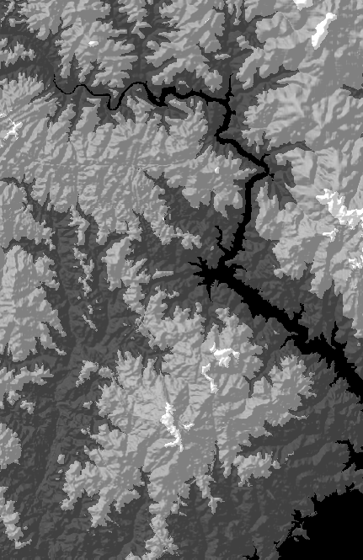
DEM
DEM with hillshade effect
High elevation: white/gray
Low elevation: Dark gray/Black

Slide 4
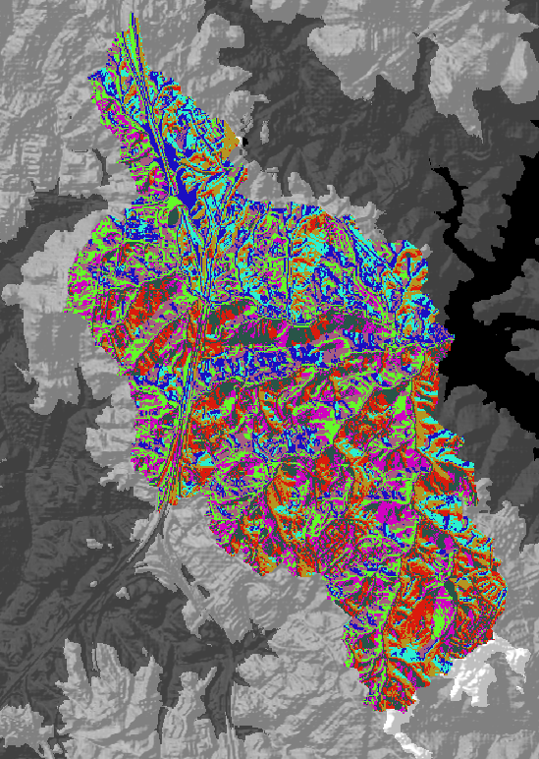
Flow direction
Spatial Analyst: ‘Flow Direction’ tool
Used to calculate flow accumulation layer.

Slide 5
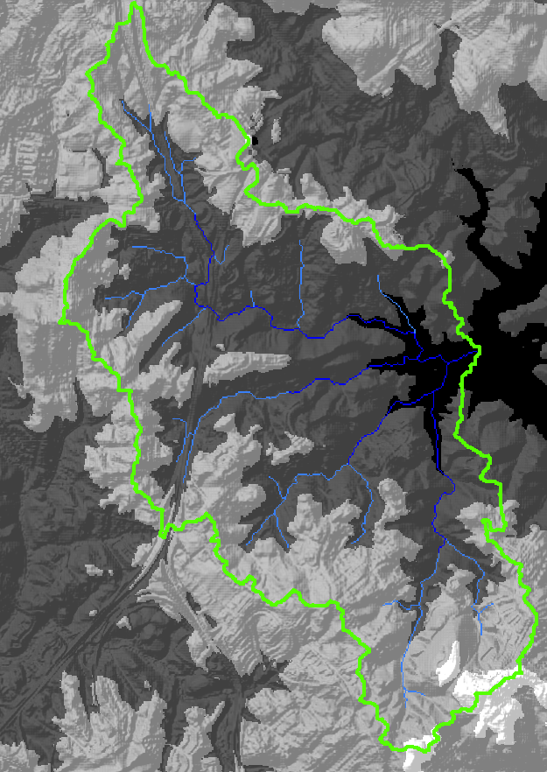
Flow accumulation
For each point on the grid, how many cells
drain to that point?

Slide 6
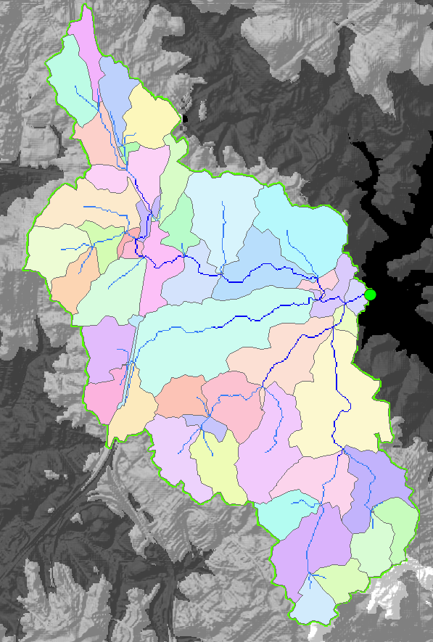
catchments
Used ‘Stream Link’ tool, to get catchments
Each stream has its own catchment.
Used to identify streams based on area
Of interest

Slide 7
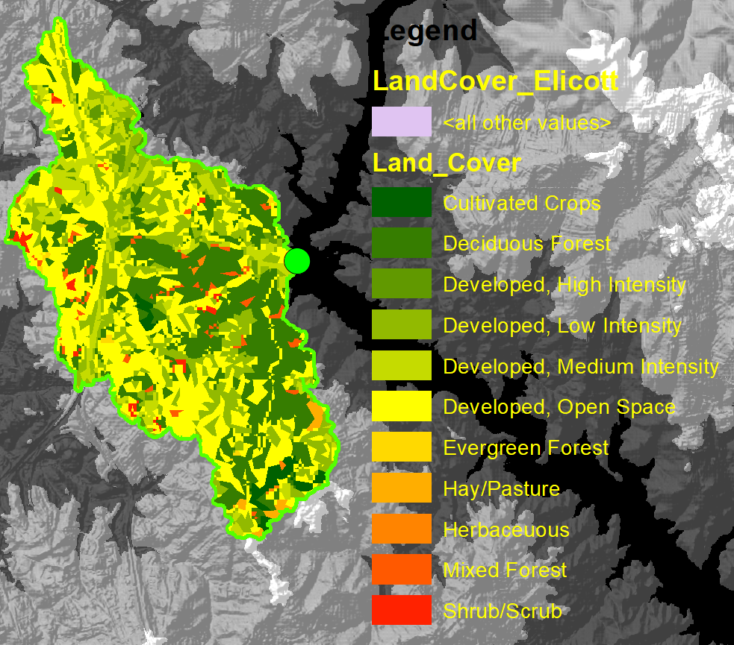
Land cover
Crops, forests near
high flow accumulation
areas

Slide 8
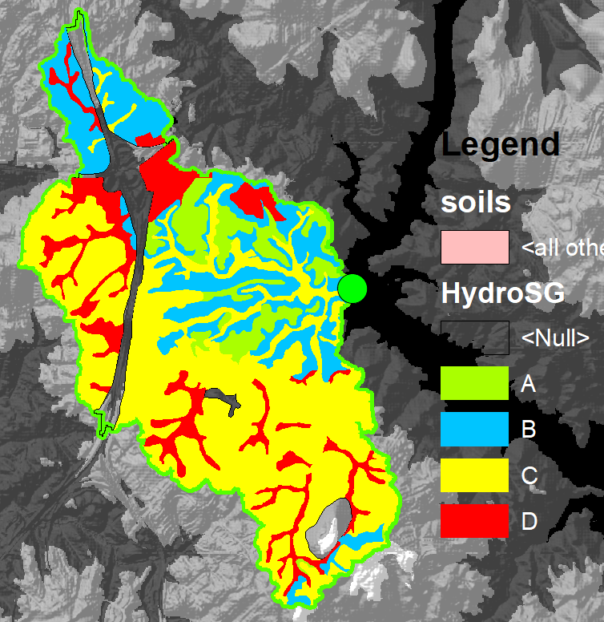
Soils
Obtained from USDA

Slide 9
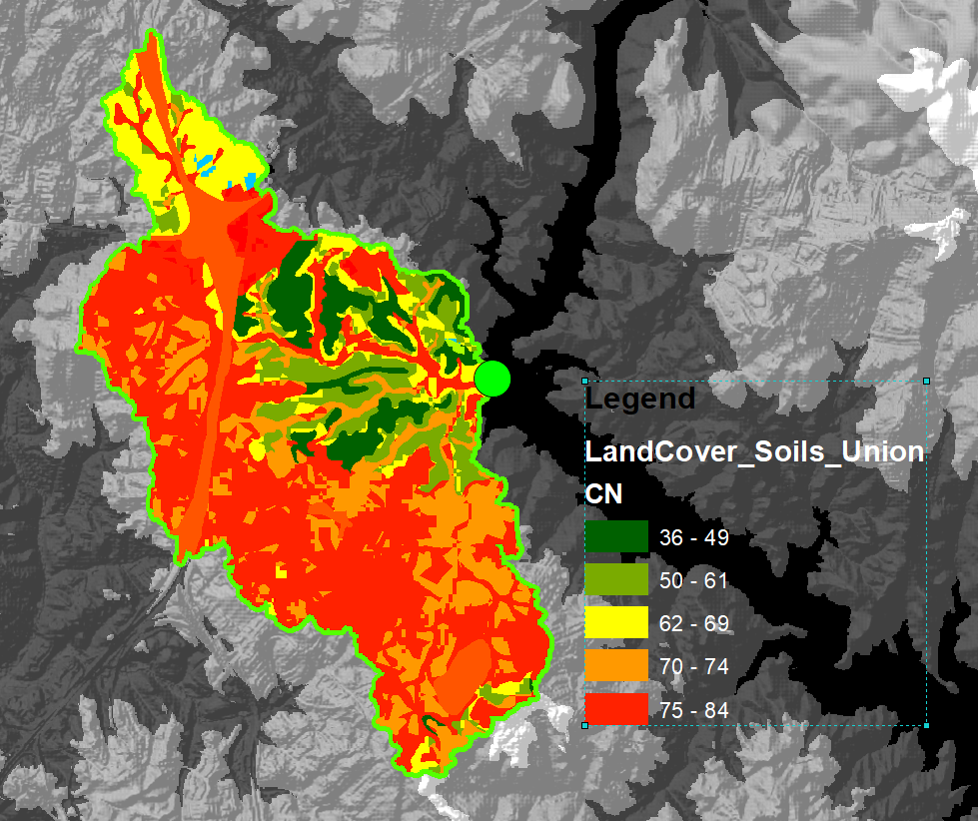
CN values
Urbanized areas
Have low CN

Slide 10
Calculations

Slide 11
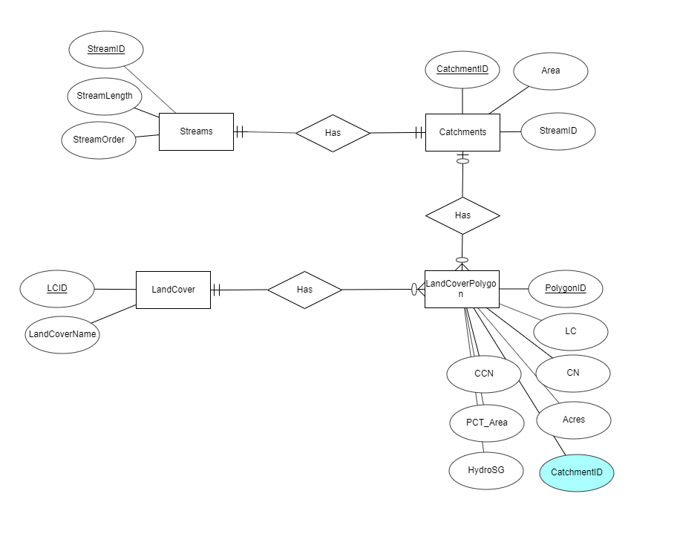
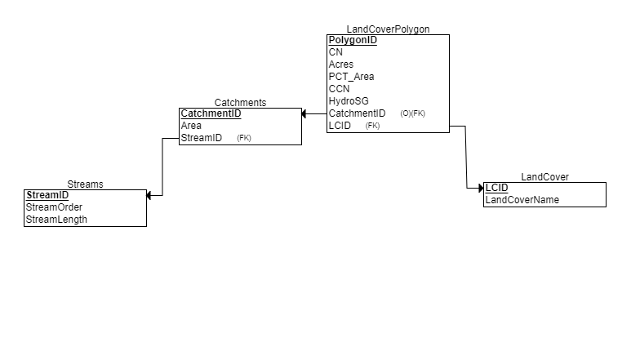
Data storage (relational model)

Slide 12
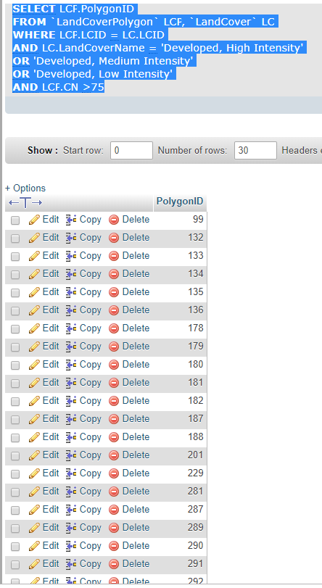
Data Analysis (mysql)
Advantages:
Can join multiple tables in select queries
Can export results into a select query, that
Can be used to select attributes in ARCGIS.
Example:
Identify developed areas with high cn values.

Slide 13
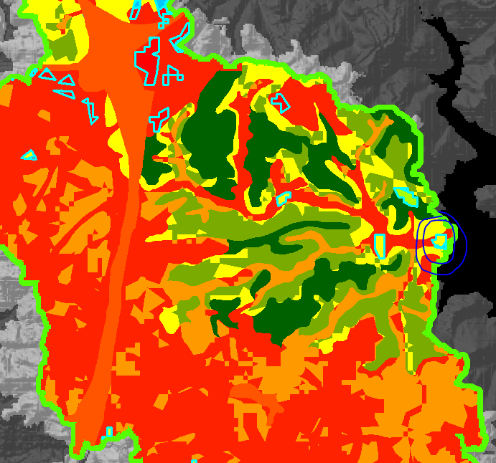
arcgis
Circled area is where
Both floods were concentrated
(Main St.)

Slide 14
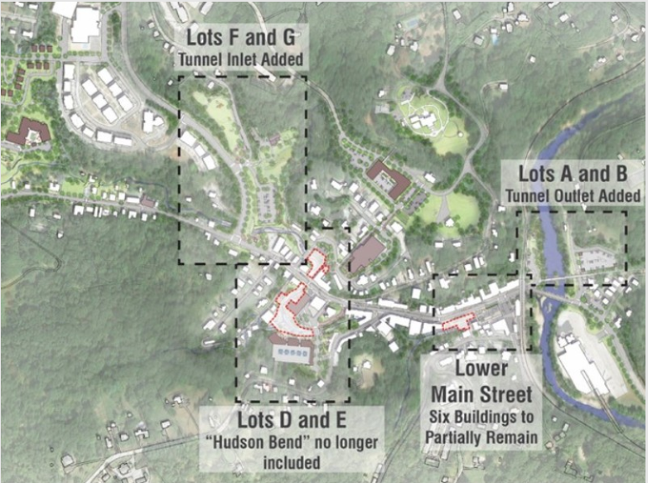
Ellicott City Watershed Master Plan
$140 million multi-tiered five-year plan
The plan includes building a tunnel requiring the removal of nine historic structures (in the identified area on Main St.)

